Slide 1


Team AE
Ryan Barker │ Will Birney
Carson Boyle │ Joey Rice
Collin Williamson

Slide 2




NANO IS A BUY!
NANO is poised for success and ready to launch!
GROWING NEED FOR CLEAN, RELIABLE, ENERGY
BUY
COMMERCIAL READY REACTOR POISED FOR PARTNERSHIP
DRIVEN LEADERSHIP FOCUSED ON LONG-TERM VALUE CREATION
Thesis
Stock
Summary
Business
Industry
Valuation
ESG
2

Slide 3
(NASDAQ:NNE) Stock Overview
NANO is undervalued and prime for growth
2025
2026
Valuation Price: $35.67
Target Price: $48.00
Current Price: $25.07
Thesis
Stock
Summary
Business
Industry
Valuation
ESG
3

Slide 4
Presentation Summary
NANO stock pitch overview
Business
KRONOS, Key Partners
01
02
Industry
Energy Needs, Investment
Valuation
DCF, Key Metrics
03
04
ESG & Risks
ESG Impact & Future
Thesis
Stock
Summary
Business
Industry
Valuation
ESG
4

Slide 5






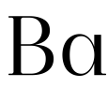
Business Overview
Backboned by KRONOS, NANO has an extremely strong value proposition
Market Cap: $1.27 B
Cash Position: $578 M
University of Illinois Urbana-Champaign
Joint Base Anacostia-Bolling
BaRupOn LLC
Thesis
Stock
Summary
Business
Industry
Valuation
ESG
5

Slide 6
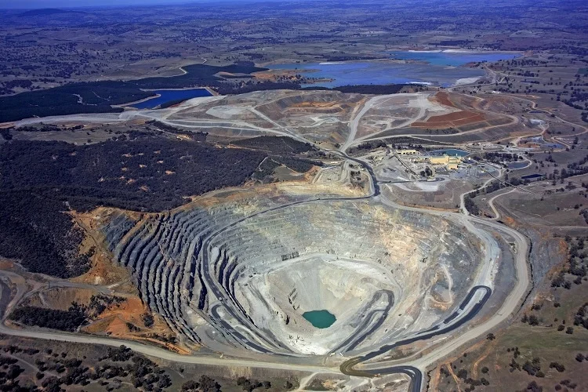
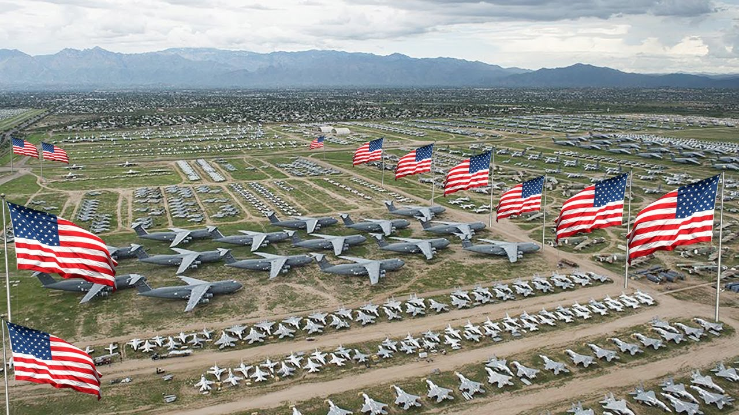


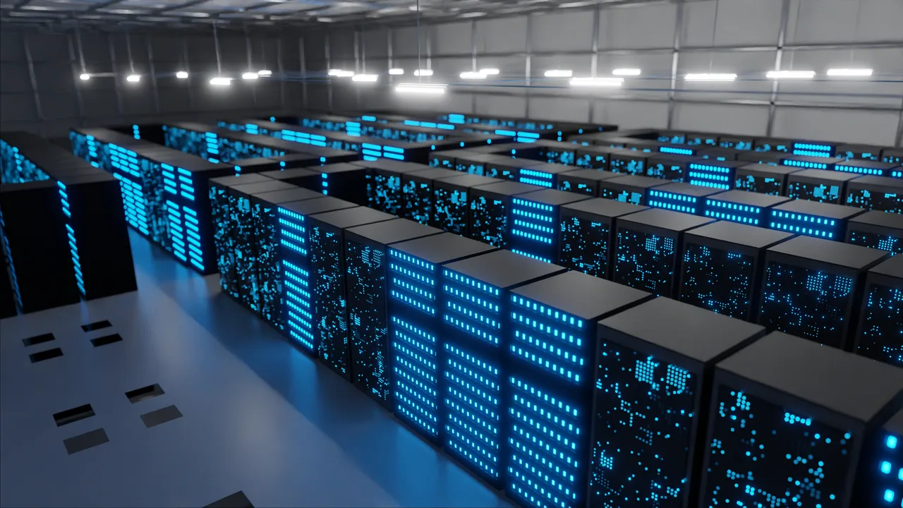
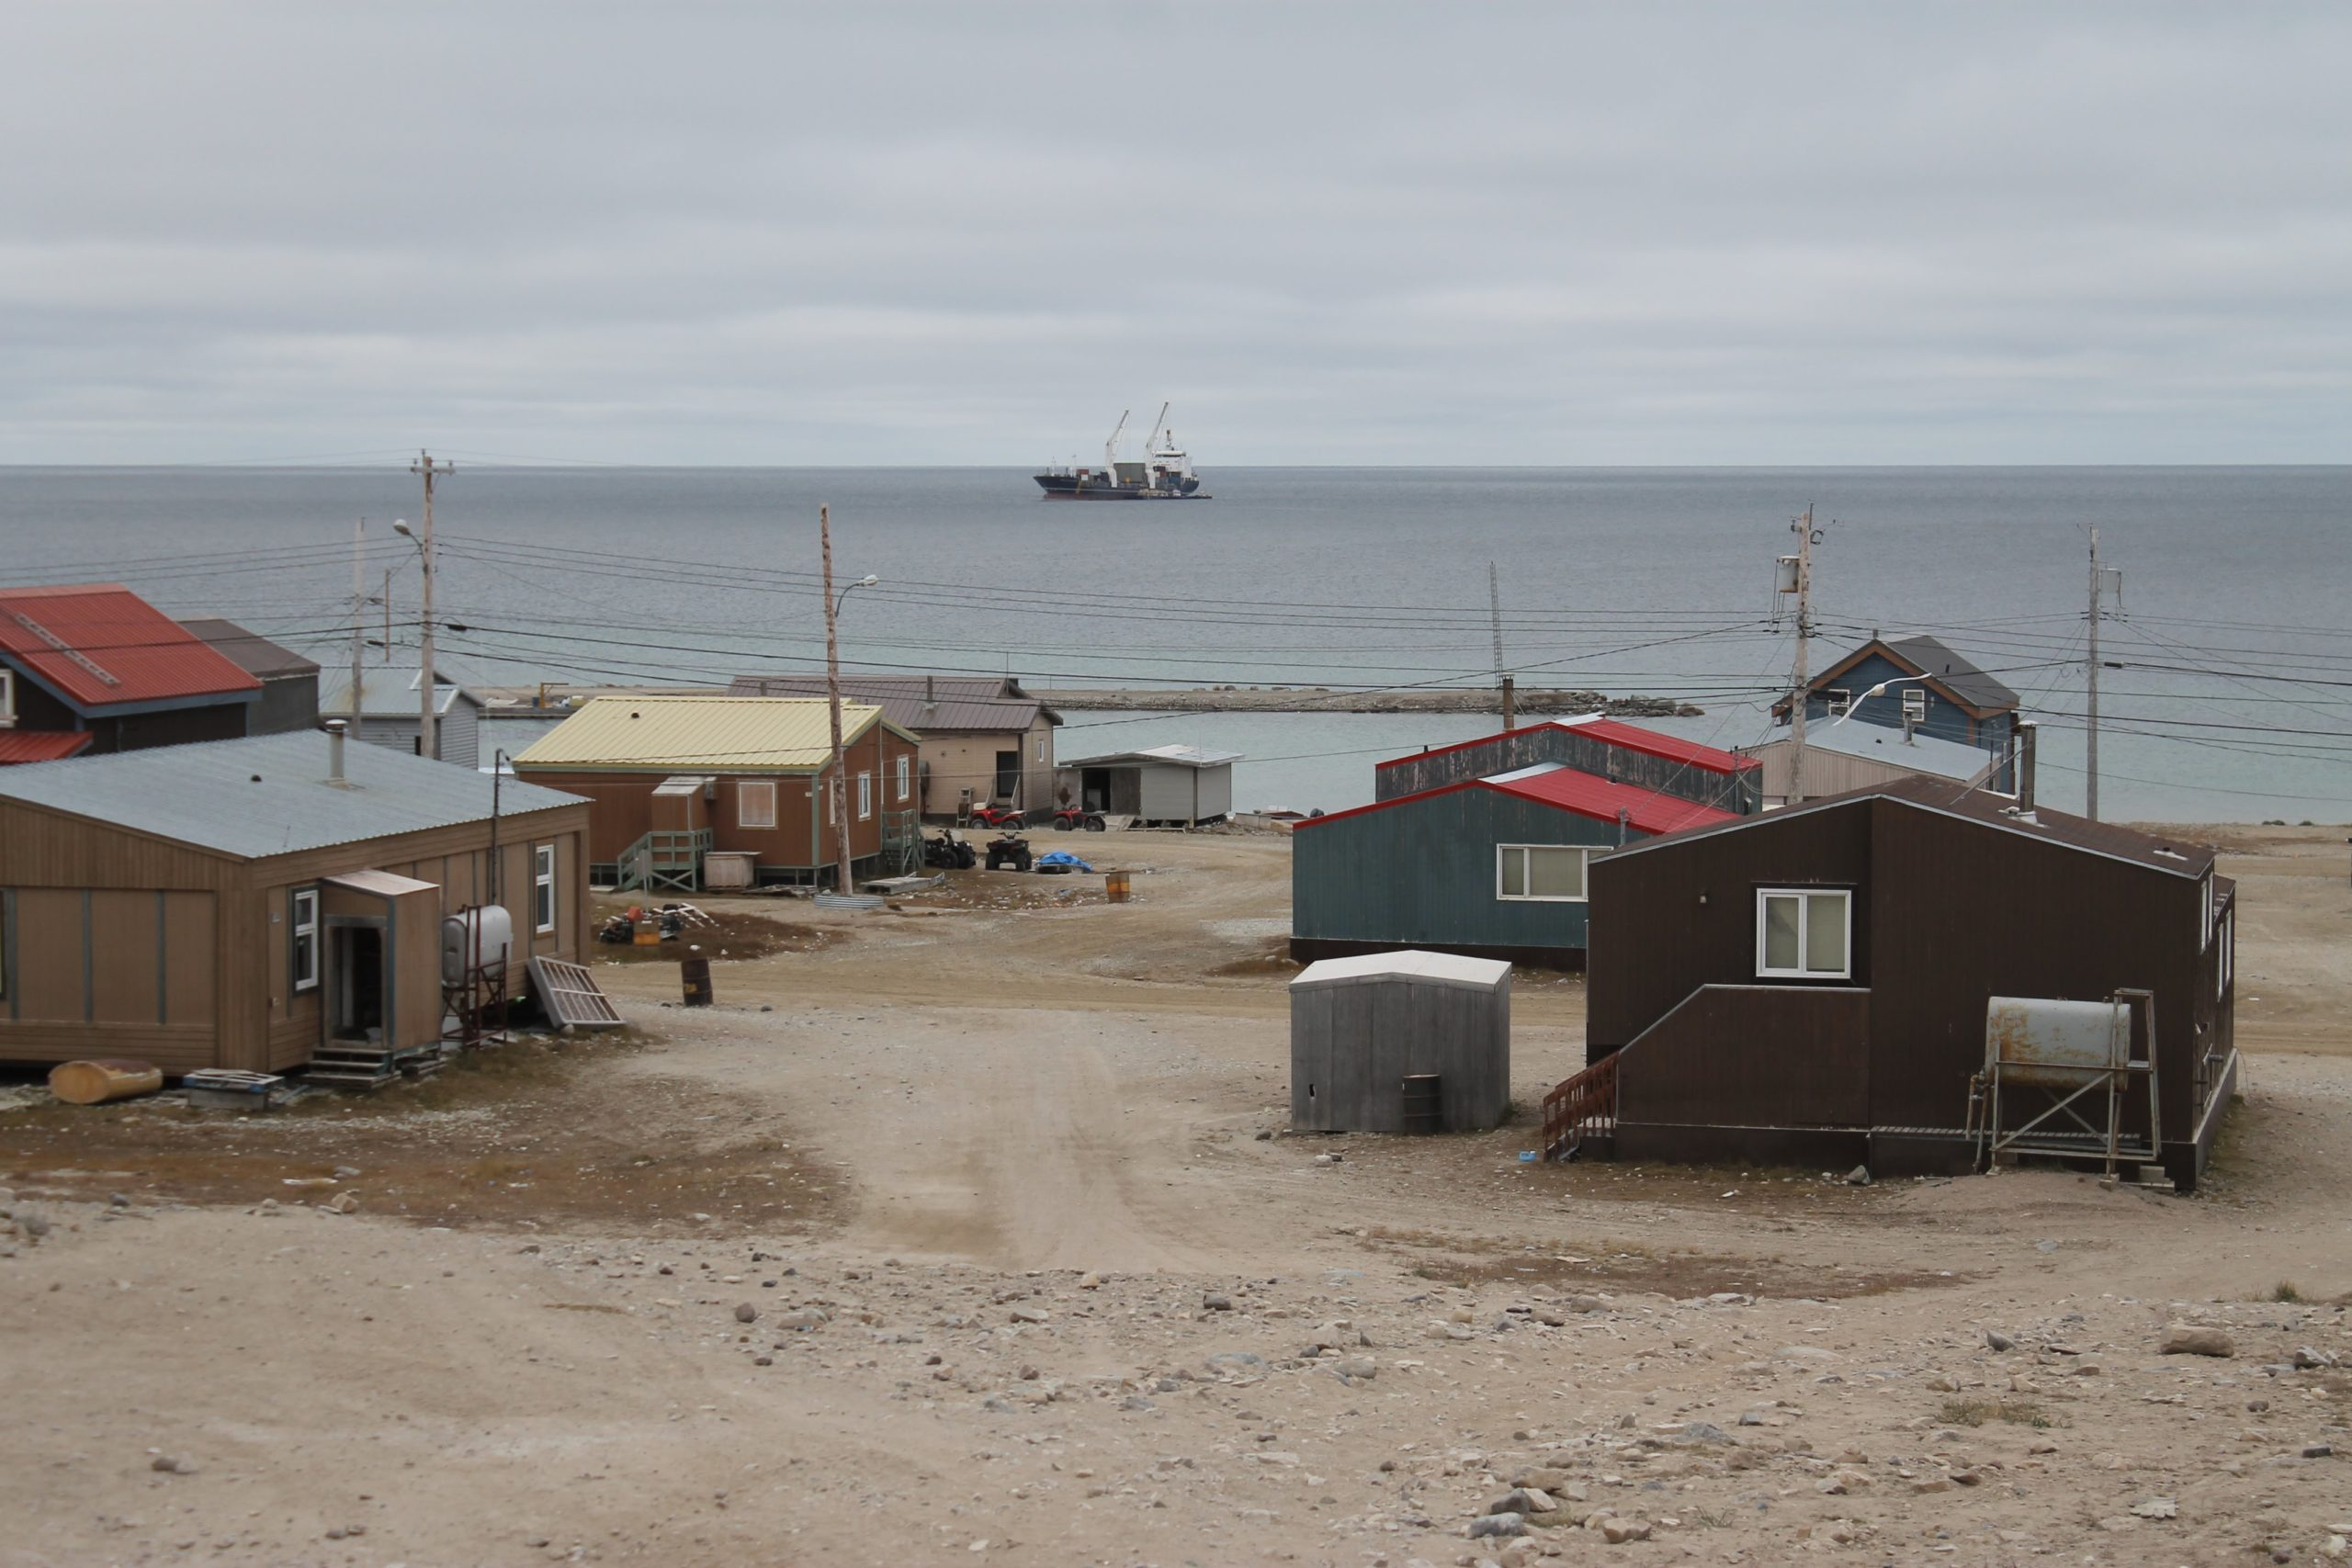


Industry Overview
Market growth conditions spark NANO’s future
US Energy Investment 2021-2025: $546.4B
EU Energy Investment 2021-2025: $835.3B
OKLO Inc: $ 10.53 B
NuScale Power Corp: $ 4.30 B
Thesis
Stock
Summary
Business
Industry
Valuation
ESG
6

Slide 7

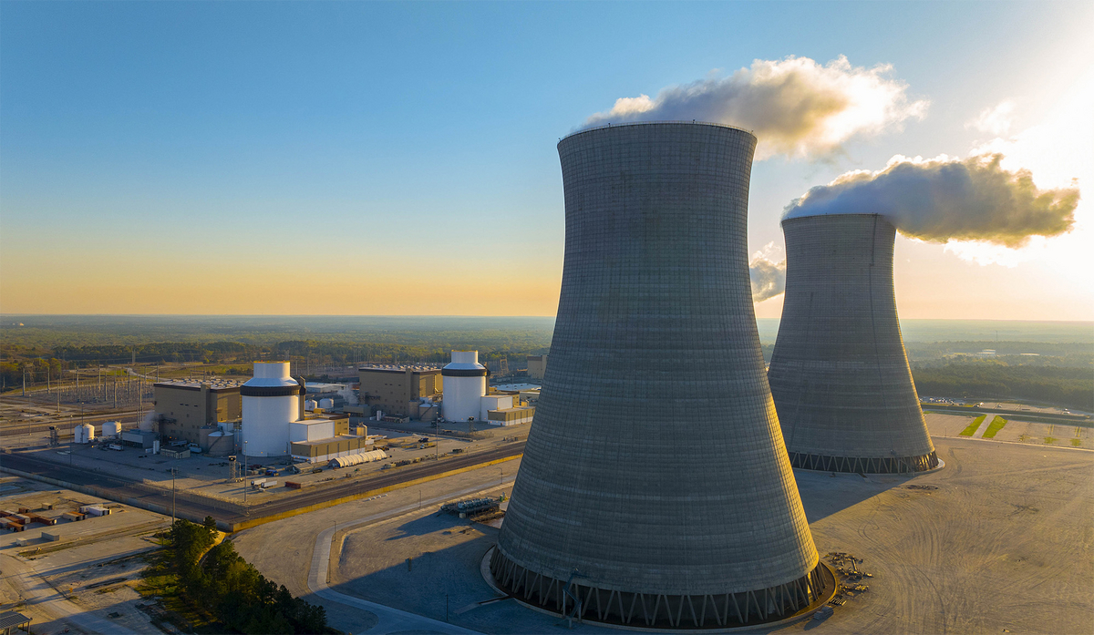


Competition
NANO is poised to take steps ahead of the competition
Large Nuclear
1+ GW
SMR
300 MW (NuScale)
Microreactor
15 MW (OKLO/NANO)
Thesis
Stock
Summary
Business
Industry
Valuation
ESG
7

Slide 8
Valuation Summary
DCF Model with Monte Carlo Validation | Target Price: $48.00 (34.57% Upside)
Method | Weight | Value
DCF (Base Case) | 70% | $46.90
Monte Carlo (Median) | 20% | $51.40
Probability-Weighted | 10% | $50.30
Weighted Target | 100% | $48.00
Target Price: $48.00
47.78% Upside from $25.07
Stock
Business
Industry
Financials
ESG
Valuation
Risks
8

Slide 9



Key Valuation Drivers
Stage-Based WACC, Core Assumptions & Target Price Derivation
Stage-Based WACC
Key Assumptions
Target Price Derivation
Stage | WACC | Timeline
Pre-License | 22% | 2025-2027
Post-Construction | 16% | 2027
Post-Operating | 13% | 2029
Commercial Ops | 11% | 2031
Mature Ops | 9% | 2035+
• FOAK Unit Cost: $350M
• Cost per kW: $23,333/kW
• Learning Rate: 85%
• Terminal Growth: 2.0%
• Capacity Factor: 90%
• Operating Life: 20 years
• Refueling Cycle: 10 years
• Annual Generation: 118,260 MWh/unit
Method | Weight | Value
DCF (Base) | 70% | $46.90
Monte Carlo | 20% | $51.40
Prob-Weighted | 10% | $50.30
Target Price | 100% | $48.00
$48.00
47.78% Upside
from $25.07 current
13 percentage point reduction reflects de-risking from pre-revenue development to established fleet operator
Investment Thesis Highlights
Long-Duration Revenue
Demand Tailwinds
Margin Expansion
Stock
Business
Industry
Financials
ESG
Valuation
Risks
9

Slide 10
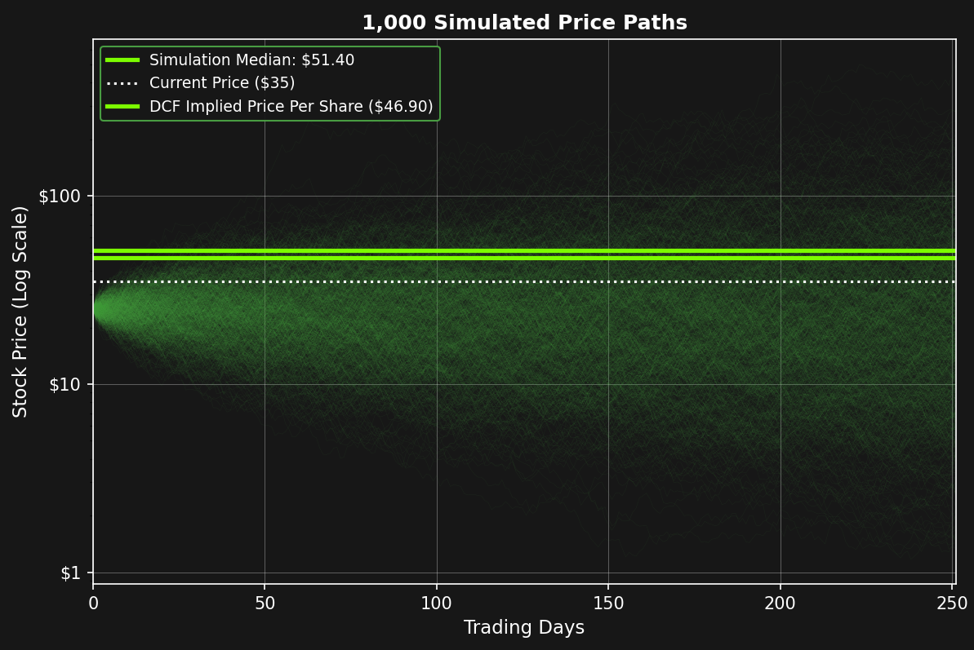
Monte Carlo Analysis
10,000 Iterations using Geometric Brownian Motion (GBM)
Stock
Business
Industry
Financials
ESG
Valuation
Risks
10

Slide 11




ESG
NANO & Nuclear energy have strong ESG ties
Environmental
Stewardship
Safety & Social
Responsibility
Strong Oversight & Transparency
Environmental (E) 7.5/10
Social (E) 6.0/10
Jay Jiang Yu, President
Governance (G) 6.5/10
BlackRock Inc
Overall ESG Score 6.7/10
Van Eck Associates Corp.
Thesis
Stock
Summary
Business
Industry
Valuation
ESG
11

Slide 12
Investment Summary
NANO is a strong BUY!
Target Price: $48.00
Current Price: $25.07
12

Slide 13
Presentation Map
1. NANO IS A BUY!
2. (NASDAQ:NNE) Stock Overview
3. Presentation Summary
4. Business Overview
5. Industry Overview
6. Competition
7. Valuation A
8. Valuation B
9. Valuation C
10. ESG
11. Investment Summary
13

Slide 14
Appendix Map
BUSINESS
1. Projected Energy Usage Growth in The United States
2. Key Sites for NANO
3. NASDAQ:NNE One-Year Stock Performance
4. Capacity Factor By US Energy Source
5. KRONOS End Market Exposure
6. Total Energy Investment From US, EU
7. FOAK KRONOS MMR Reactor Commercialization Timeline
INDUSTRY
8. Europe's Natural Gas Import Dependence
9. Europe's Natural Gas Import Prices
10. Electricity vs. Natural Gas Consumption
11. Projected US Data Center Growth Demand
COMPETITION
12. KRONOS Unit Deployment Schedule
13. Uranium Enrichment Levels In Reactor Fuel
VALUATION
14. NANO PPA Revenue 2025-2050
15. YOY CAPEX Projections 2025-2050
16. FCF Bear vs. Base vs. Bull 2025-2050
17. Capital Costs Per KRONOS Unit
18. KRONOS MMR Cost Assumptions
19. KRONOS MMR Cost vs Revenue Assumptions
20. Capital Costs Per KRONOS Fleet Deployment
21. Stage Based WACC KRONOS Assumptions
22. NANO Monte Carlo Simulations
23. Breakeven Points by Sector LCOE
24. Key Milestone & Valuation Assumptions
25. Year-by-Year Projections
26. Revenue Projections By Market
FINANCIAL ANALYSIS
27. NANO Financial Summary
28. NANO Cash Position
ESG
29. Greenhouse Gas Emissions
30. Land Use per TWh
31. Deaths by Energy Source per TWh
32. Nuclear Energy Providing Jobs and Opportunities
33. Shareholder Ownership Structure
34. NANO Nuclear ESG Scorecard & Key Pillars
35. Future ESG Opportunities For NANO
RISKS
36. Risk Matrix
14

Slide 15
BUSINESS
15

Slide 16
Projected Energy Usage Growth in The United States
Data from 1950A-2030E
16
Source: Grid Strategies

Slide 17
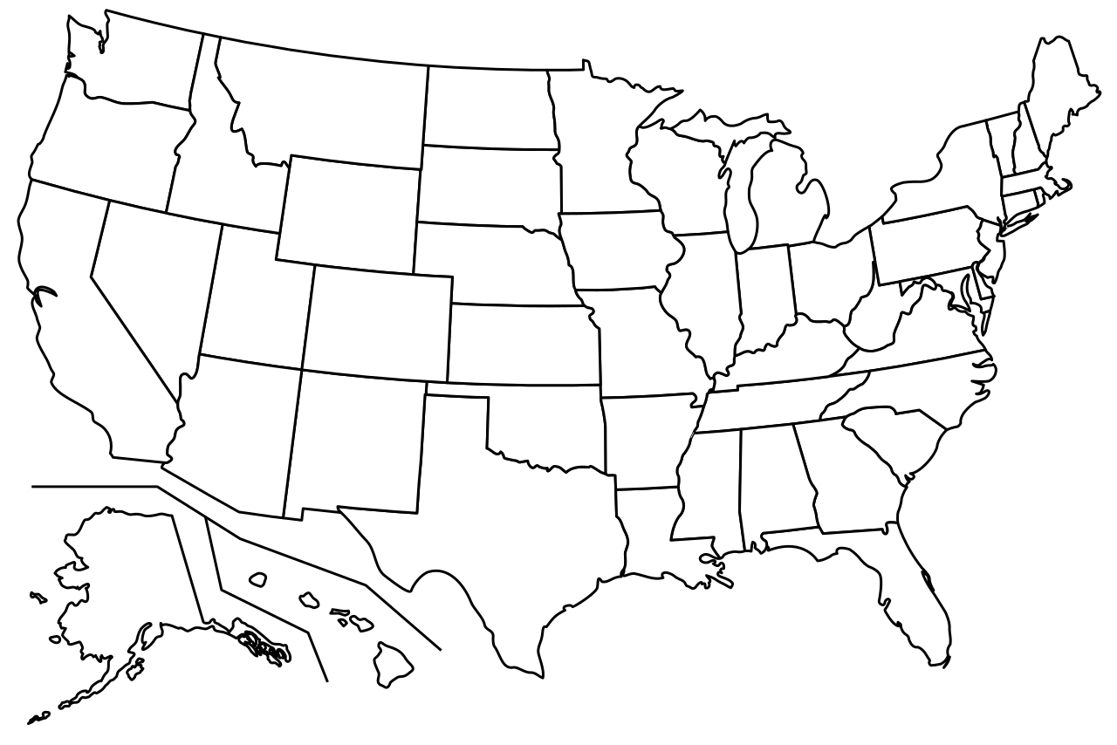
Key Sites for NANO
Located in United States
Joint Base Anacostia-Bolling
University of Illinois UC
BaRupOn LAMP
NANO Headquarters
17
Source: NANO Nuclear

Slide 18
NASDAQ:NNE One-Year Stock Performance
Stock Data as of 2026-02-18
18
Source: Yahoo Finance

Slide 19
Capacity Factor By US Energy Source
From 2024 Study
19
Source: ITIF

Slide 20
KRONOS End Market Exposure
Based on 2050 Revenue Projections
20
Source: Team Analysis

Slide 21
Total Energy Investment From US, EU in ($B)
Energy Investment Growth from 2016-2025
21
Source: Reuters

Slide 22
FOAK KRONOS MMR Reactor Commercialization Timeline
Based on NANO & Team Projections
FOAK KRONOS MMR Reactor Regulatory/Commercialization Timeline
NANO and UIUC announce FOAK KRONOS Build
Non-nuclear Construction continues at UIUC
FOAK KRONOS is Online & Operational
Jan 2025
Jan 2026
Q2 2027
Apr 2025
Q3 2026
Q4 2029
NANO Acquires KRONOS From USNC
Construction Permit Submitted For KRONOS
Operating License Submitted For KRONOS
22
Source: Team Analysis, NANO Nuclear

Slide 23
INDUSTRY
23

Slide 24
Europe’s Natural Gas Import Dependence
Europe’s Natural Gas Imports from 2014-2025
24
Source: EuroStat

Slide 25
Europe’s Natural Gas Import Prices
Natural Gas Prices from 2019-2025
25
Source: International Energy Agency

Slide 26
Electricity vs. Natural Gas Consumption
Global Demand from 2015-2020
26
Source: International Energy Agency

Slide 27
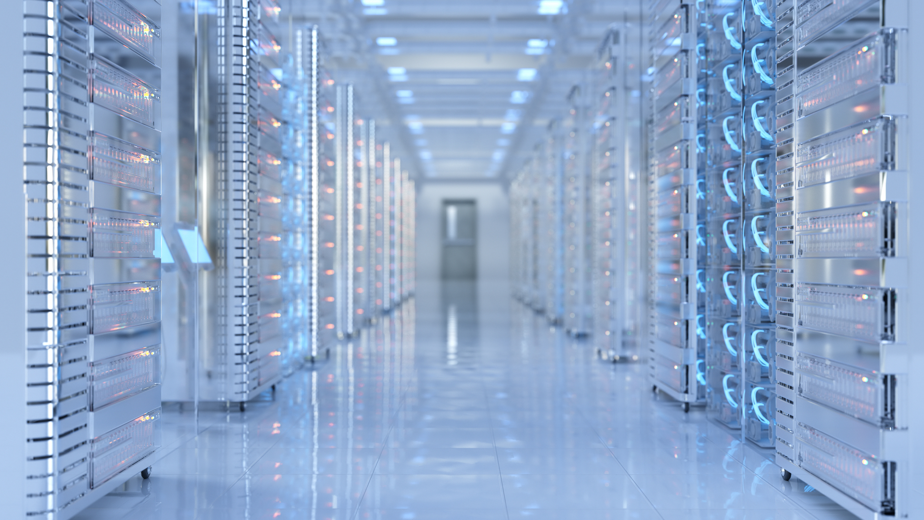
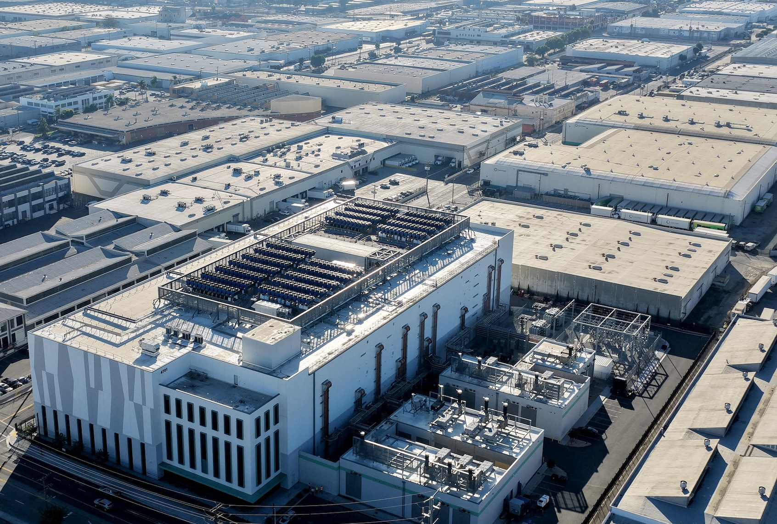
Projected US Data Center Growth Demand
US Data Center Demand from 2023A-2030E
27
Source: McKinsey

Slide 28
COMPETITION
28

Slide 29
KRONOS Unit Deployment Schedule
Team Analysis Forecasting KRONOS Unit Runout
29
Source: Team Analysis

Slide 30
Uranium Enrichment Levels In Reactor Fuel
Uranium Enrichment Levels by Fuel Type
30
Source: NANO Nuclear

Slide 31
VALUATION
31

Slide 32
NANO PPA Revenue 2025-2050 (in $M)
Team Analysis Driven Revenue Projections for KRONOS/NANO
32
Source: Team Analysis

Slide 33
YOY CAPEX Projections 2025-2050 (in $M)
Team Analysis Driven CAPEX Projections for KRONOS/NANO
33
Source: Team Analysis, NANO Nuclear

Slide 34
FCF Bear vs. Base vs. Bull 2025-2050 (in $M)
Team Analysis Driven FCF Projections for KRONOS/NANO by Case
34
Source: Team Analysis

Slide 35
Capital Costs Per KRONOS Unit (in $M)
KRONOS Unit Cost Projections by Unit
35
Source: Team Analysis, NANO Nuclear

Slide 36
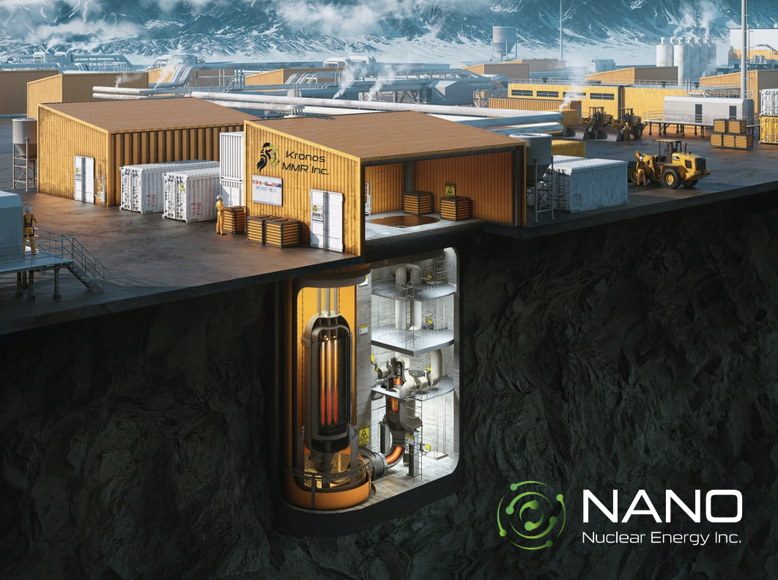
KRONOS MMR Cost Assumptions
Key Operating Cost Assumptions
Fuel (HALEU) – $30/MWh
Fixed O&M – $20/MWh
Insurance – $18/MWh
Regulatory/NRC – $10/MWh
Total – $78/MWh
36
Source: Team Analysis

Slide 37
KRONOS MMR Cost vs Revenue Assumptions
Key Operating Cost ($/MWh) vs Revenue Assumptions ($/kWh)
37
Source: Team Analysis

Slide 38
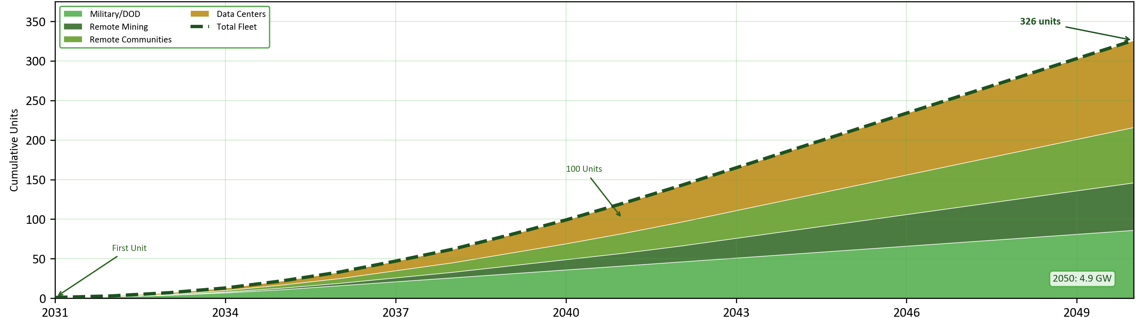
Capital Costs Per KRONOS Fleet Deployment by Marget Segment (2031-2050) (in $M)
KRONOS Unit Fleet Deployment Projections by Market
38
Source: Team Analysis, NANO Nuclear

Slide 39
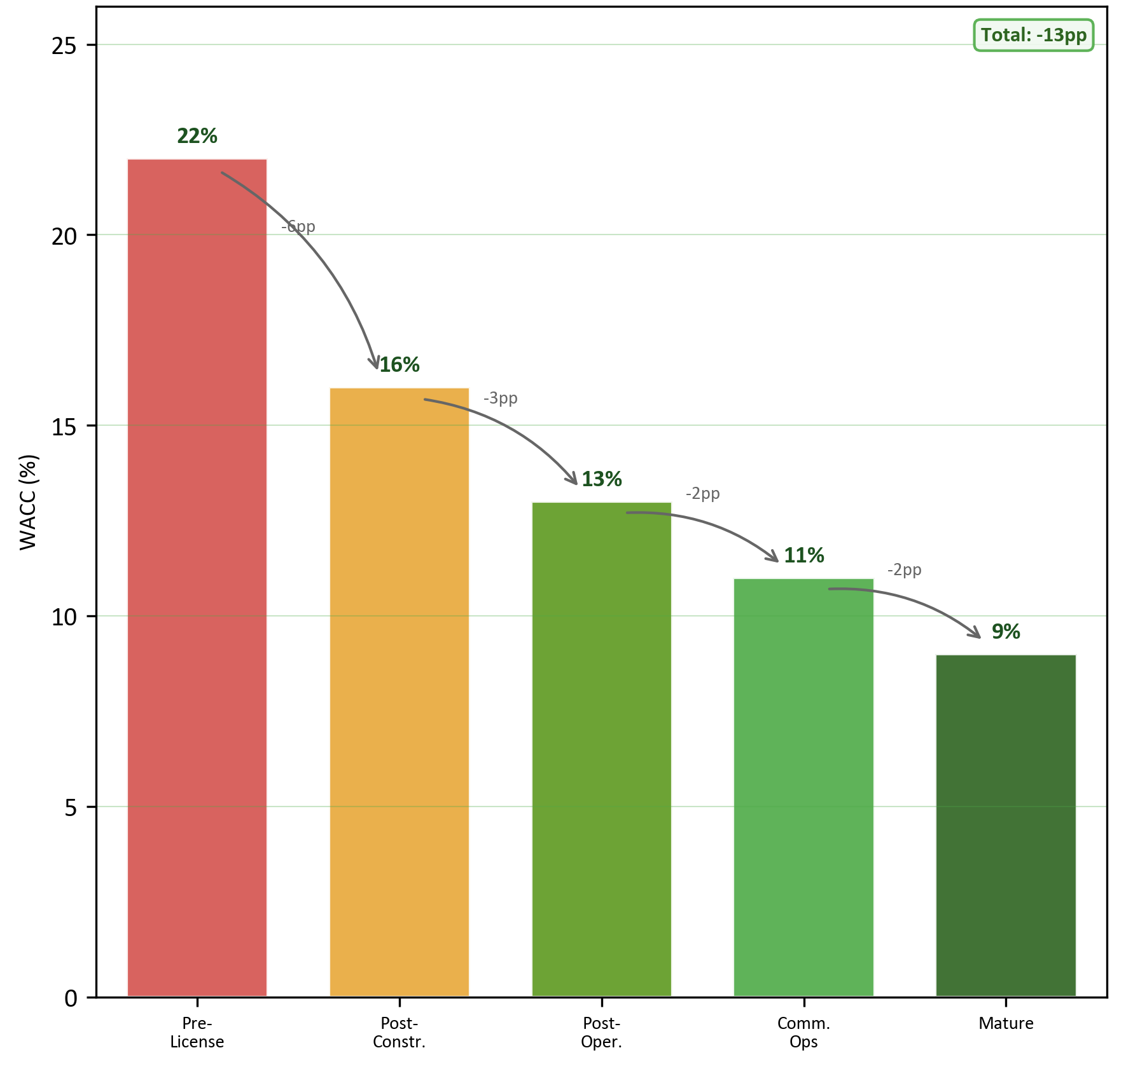
Stage Based WACC KRONOS Assumptions
Dynamic WACC
Pre-Licensing Stage – 22%
Post Construction Stage – 16%
Post Operating Stage – 13%
Commercial Operations – 11%
Mature Operations Stage – 9%
39
Source: Team Analysis

Slide 40
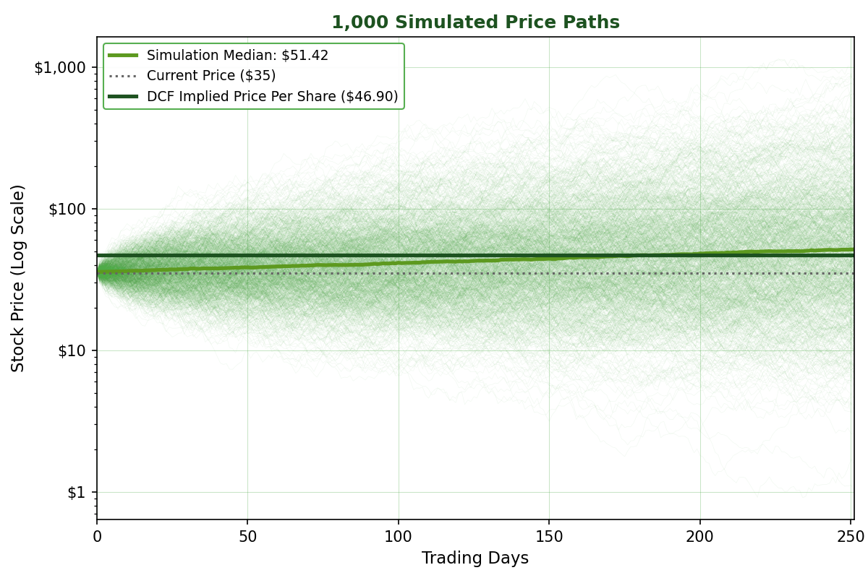
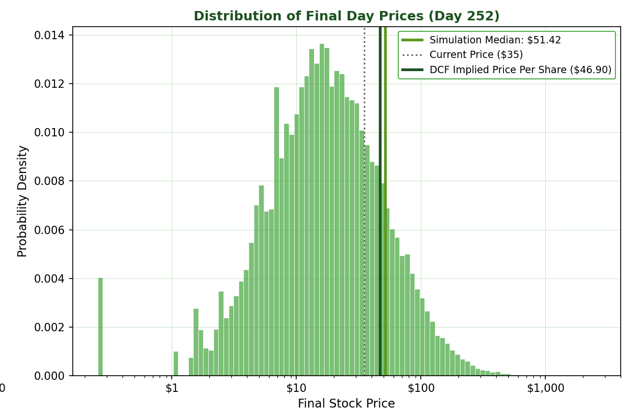
NANO Monte Carlo Simulations
1,000 Simulated Price Paths & Simulation Histogram Charts
40
Source: Team Analysis

Slide 41
Breakeven Points by Sector LCOE
Levelized Cost of Energy Break Even Points
41
Source: Team Analysis

Slide 42
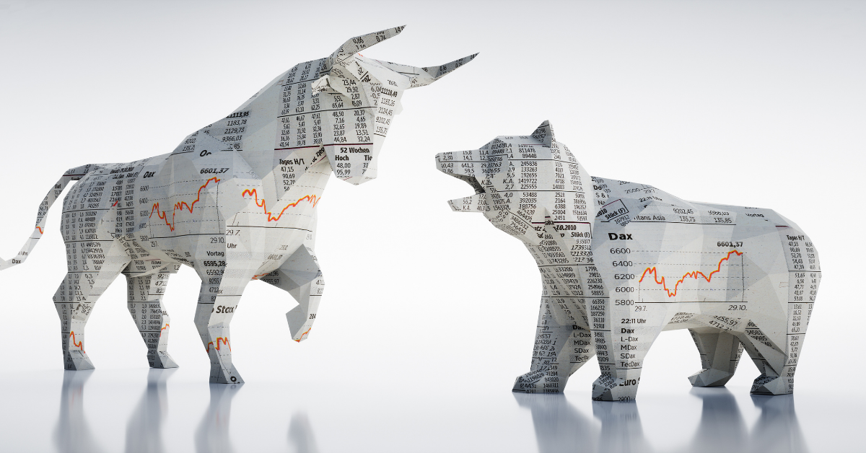
Key Milestone & Valuation Assumptions
Regulatory Milestone and Case by Case Valuation Assumptions
42
Source: Team Analysis

Slide 43
Year-by-Year Projections
Team Driven DCF Results
43
Source: Team Analysis

Slide 44
Revenue Projections By Market
Revenue Projections (2025-2050)
44
Source: Team Analysis

Slide 45
FINANCIAL ANALYSIS
45

Slide 46
NANO Financial Summary
NNE Consolidated Financial Summary (2022A-2037E)
 | 2022A | 2023A | 2024A | 2025E | 2026E | 2027E | 2028E | 2029E | 2030E | 2031E | 2032E | 2033E | 2034E | 2035E | 2036E | 2037E
Revenue ($M) | - | - | - | - | - | - | - | - | - | 35.50 | 85.20 | 199.90 | 379.60 | 638.60 | 947.30 | 1,329.20
Cost of Sales / OpEx ($M) | - | - | - | - | - | - | - | - | - | (9.20) | (27.70) | (64.60) | (119.90) | (202.90) | (304.40) | (433.50)
Gross Profit ($M) | - | - | - | - | - | - | - | - | - | 26.30 | 57.50 | 135.30 | 259.70 | 435.70 | 642.90 | 895.70
G&A Expenses ($M) | (0.90) | (5.00) | (6.50) | (25.00) | (25.00) | (25.00) | (25.00) | (25.00) | (25.00) | (25.70) | (26.70) | (29.00) | (32.60) | (37.80) | (43.90) | (51.60)
EBITDA ($M) | (1.10) | (6.30) | (8.40) | (40.40) | (25.00) | (25.00) | (25.00) | (25.00) | (25.00) | 0.60 | 30.80 | 106.30 | 227.10 | 397.90 | 599.00 | 844.10
MARGINS & RATIOS
Gross Margin (%) | - | - | - | - | - | - | - | - | - | 74.1% | 67.5% | 67.7% | 68.4% | 68.2% | 67.9% | 67.4%
EBITDA Margin (%) | - | - | - | - | - | - | - | - | - | 1.7% | 36.2% | 53.2% | 59.8% | 62.3% | 63.2% | 63.5%
CASH FLOW
Operating Cash Flow ($M) | (0.60) | (3.90) | (8.50) | (25.00) | (25.00) | (25.00) | (25.00) | (25.00) | (25.00) | 0.60 | 30.80 | 106.30 | 227.10 | 397.90 | 599.00 | 844.10
CapEx ($M) | - | - | - | - | - | - | - | - | - | -350.0 | -568.0 | -944.6 | -1214.8 | -1604.4 | -1765.9 | -2060.3
Free Cash Flow ($M) | (0.60) | (3.90) | (8.50) | (25.00) | (25.00) | (25.00) | (25.00) | (25.00) | (25.00) | (349.40) | (537.20) | (838.30) | (987.70) | (1,206.50) | (1,166.90) | (1,216.20)
CASH BURN METRICS
Annual Cash Burn ($M) | (0.60) | (3.90) | (8.50) | (25.00) | (25.00) | (25.00) | (25.00) | (25.00) | (25.00) | (349.40) | (537.20) | (838.30) | (987.70) | (1,206.50) | (1,166.90) | (1,216.20)
46
Source: Team Analysis

Slide 47
NANO Cash Position (in $M)
NANO Cash Until Deployment in 2032
47
Source: Team Analysis

Slide 48
ESG
48

Slide 49
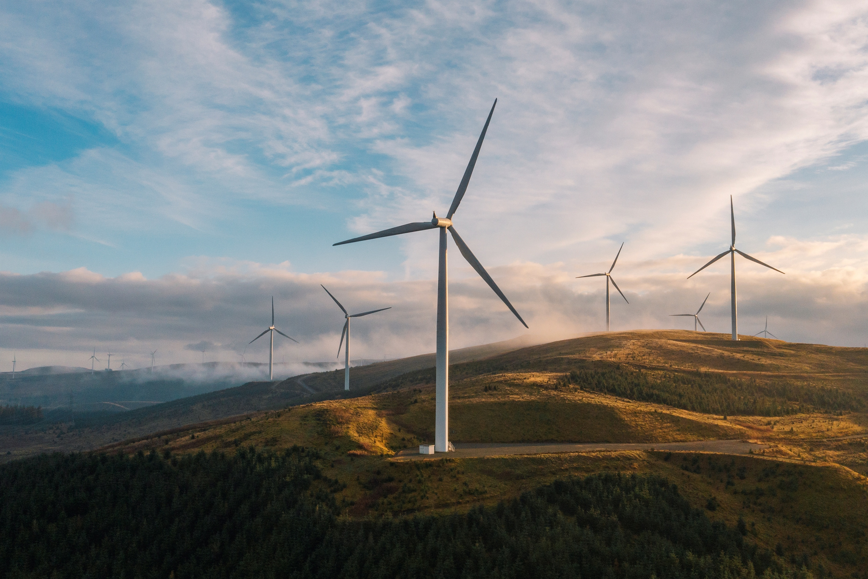
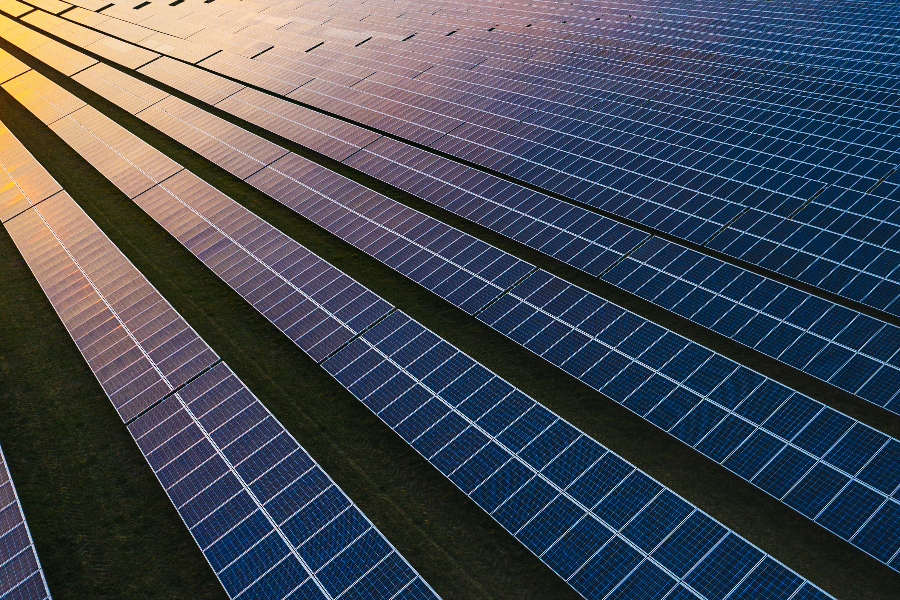
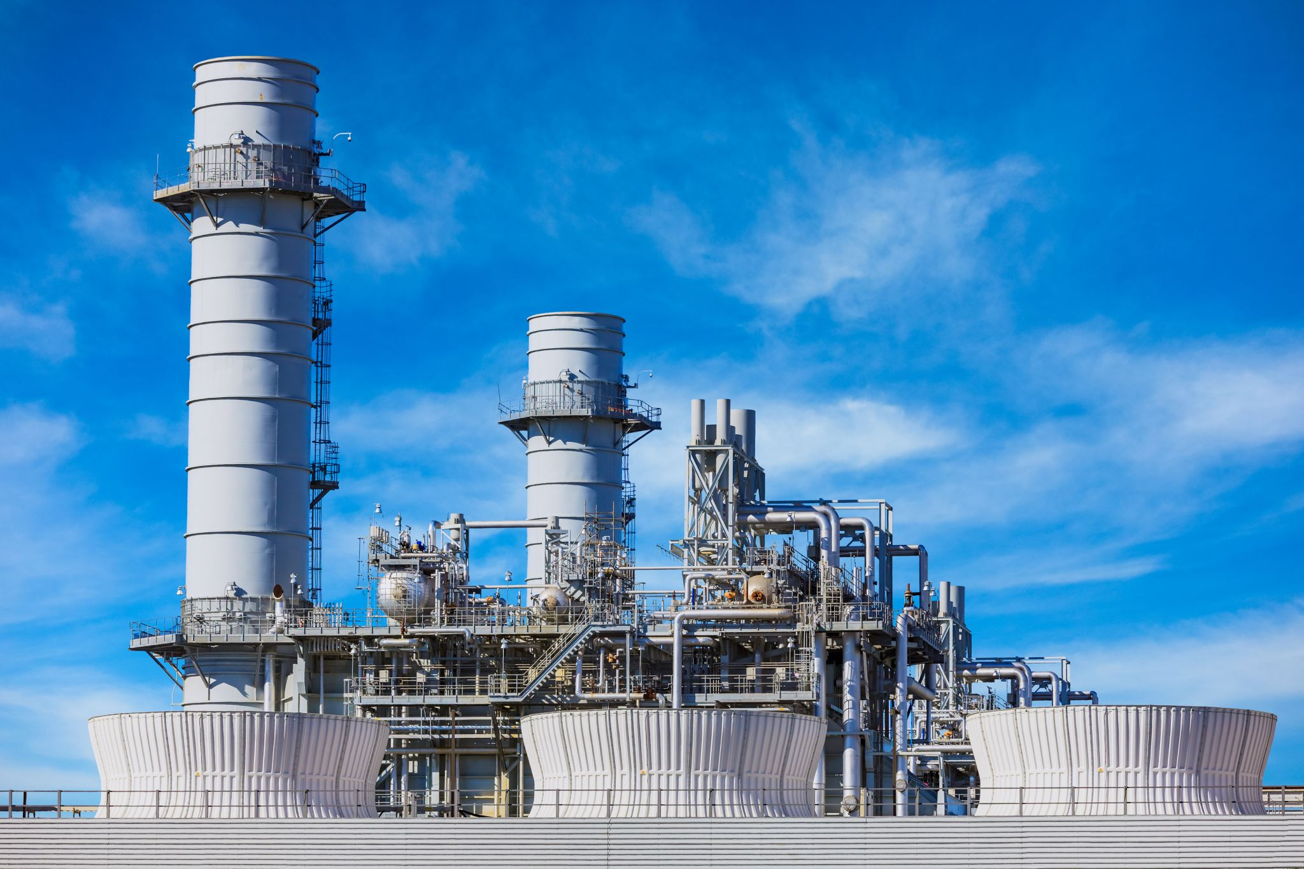
Greenhouse Gas Emissions
Lifecycle Greenhouse Gas Emissions By Energy Source
49
Source: IPCC

Slide 50


Land Use per TWh
Land Use in (km²) per Terawatt-hour
50
Source: IPCC

Slide 51
Deaths by Energy Source per TWh
Deaths per Terawatt-hour
51
Source: NucNet

Slide 52

Nuclear Energy Providing Jobs and Opportunities
US Nuclear Workforce and Compensation Premium
67,900
Direct US Nuclear Jobs
27% ​
Wage Premium vs Other Electricity Sources​
52
Source: NucNet

Slide 53


Shareholder Ownership Structure
Ownership Breakdown & Major Shareholders
Jay Jiang Yu, President
James Walker, CEO
BlackRock, INC
Van Eck Associates Corp.
I Financial Ventures Group LLC.
53
Source: NANO Nuclear

Slide 54
NANO Nuclear ESG Scorecard & Key Pillars
Team Driven Proprietary ESG Scorecard
Environmental (E) 7.5/10
Environmental
Stewardship
Social (E) 6.0/10
Safety & Social
Responsibility
Strong Oversight & Transparency
Governance (G) 6.5/10
Overall ESG Score 6.7/10
54
Source: Team Analysis

Slide 55
Future ESG Opportunities For NANO
Team Driven ESG Future Outlook
Opportunity Dimension | Fossil Fuels | Renewables | Advanced Nuclear (NANO)
Carbon Emissions | High | Low | Zero
Baseload Reliability | High | Low | High
Land Use Intensity | Moderate | High | Low
Energy Security | Medium | Medium | High
55
Source: Team Analysis

Slide 56
RISKS
56

Slide 57
Risk Matrix
Team Analysis Driven Risk Matrix for NANO Nuclear
R&P #1
Regulatory & Political Risks
M #2
R&P #1 - Nuclear Regulatory Approval Risk
R&P #2
O #1
R&P #2 - Policy Reversal Risk
O #2
R&P #3 - Geopolitical Uranium & Fuel Cycle Risk
R&P #4 - Nuclear Liability & Insurance Framework Risk
R&P #3
Operational Risks
Impact
R&P #4
M #1
O #1 - Pre-Revenue Execution Risks
O #2 - Project Development & Construction Risks
O#3 - Supply Chain Integration Risk
O#4 - Increased Engineering Talent Costs
O #3
Market Risks
M #3
O #4
M#1 - Competition From Alternative Energy Sources
M#2 - Electricity Price & PPA Risk
M#3 - Limited Institutional Investor Adoption
Low Medium High
Probability
57
Source: Team Analysis

